Slide 1
Project 28: Electronically Steerable Catheter
Zane Johnson, Matt Situmeang, Erin McFadden, Michael Pass, Tanner Karbonik
Notes:
Matthew - Basic Introduction, Ad lib

Slide 2
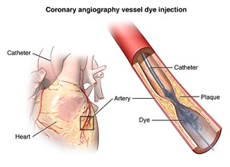
Background Knowledge (1/2)
A catheter is a long, tubular device used to access otherwise difficult to reach vasculature
Used in a number of different procedures:
Drug delivery
Balloon angioplasty
Stent deployment
Measuring fluid pressures in remote spaces
Fluid drainage
Notes:
Matthew - Just describing catheters in general.

Slide 3
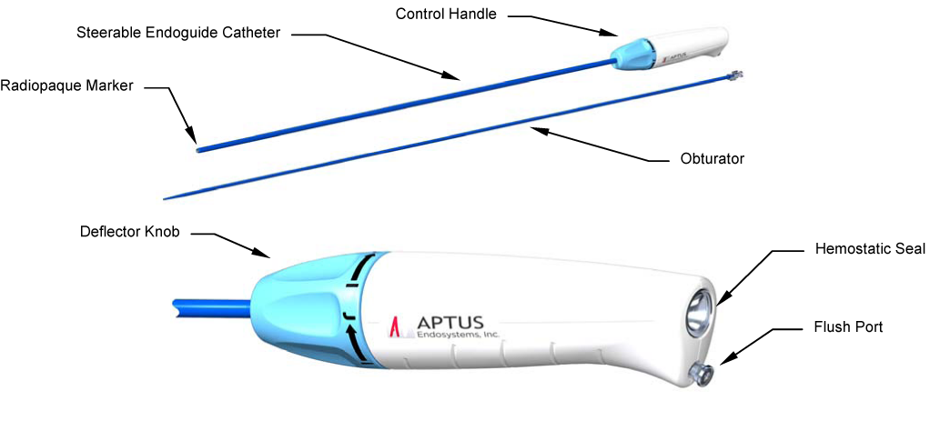
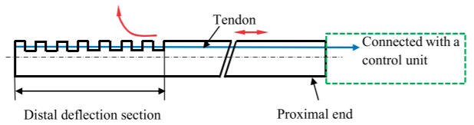
Background Knowledge (2/2)
Steerable catheters used for accessing remote vasculature with branching
System of tendons, soft distal material with rigid backbone, and control handle
Notes:
Michael

Slide 4
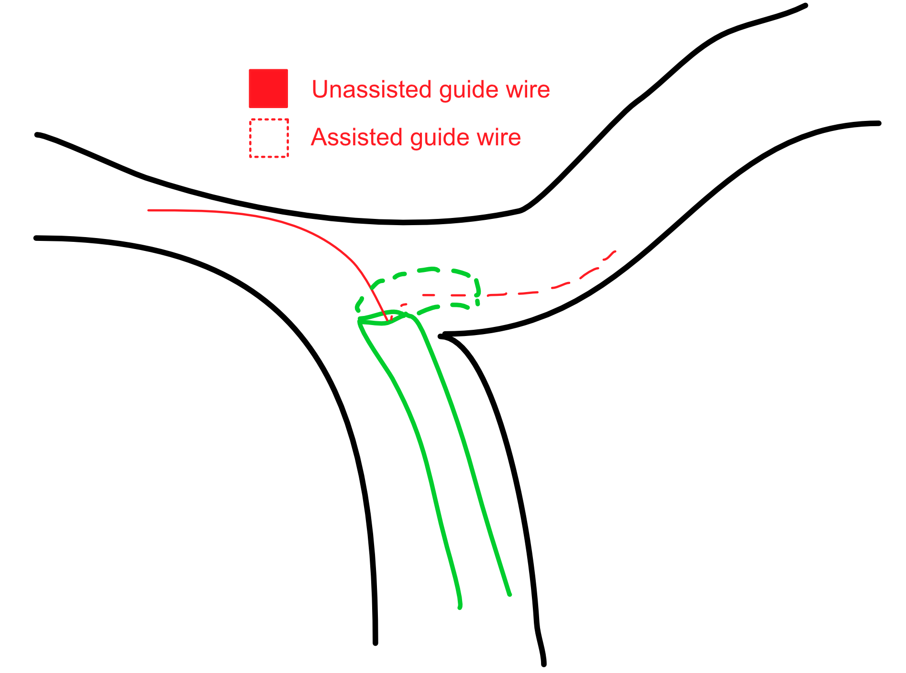
Notes:
Michael - Define what a steerable catheter is.

Slide 5

Approach
Initial research was conducted individually
Established master list of questions
Narrowed down to focus on Need Statement
Mentors interviewed
Medical Murray engineers
Interviews scheduled with physicians at Iowa Heart Center at Mercy Hospital
Notes:
Tanner K

Slide 6
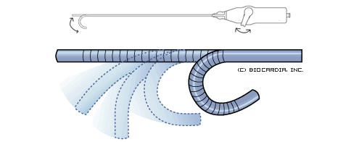
Problems with Current Design
Ease of use
Multiple hands to operate
Complex control system
Restrictions of mechanical movement
Less precision
Limited ROM
Increased procedure time
Notes:
Erin

Slide 7

Relevance
Revolutionizing healthcare field from a procedural standpoint
Decreasing procedure time
More precise, hand-held catheter
Improving patient outcomes
Cost of magnetic, automated catheters $1.2-1.5 million
Target cost of our design ~$200
Notes:
Zane

Slide 8
A way to improve the usability and actuation of steerable catheters controlled by surgeons to increase surgical accuracy and decrease procedural time.
Notes:
ZANE!!!! Close out.

